Slide 1

Chocolate Sales Analytics
Presented by
Shivani kale

Slide 2
Table Of Contents
Problem Statement
Key Metrics
Dashboard Customer
Demographics Sales
Trend Brand and Product Statistics
Geographical Sales

Slide 3
Problem Statement
Analyze chocolate sales data by customer demographics, brand, and product categories across diverse geographic locations. Also, include the sales trends over various time periods throughout the year 2021.

Slide 4
Key Metrics
Customer Demographics
Total Purchase ($) - Gender-wise
Total Purchase ($) by Age Group
Younger Age
Middle Age
Older Age
Total Purchase ($) by Loyalty Status
Platinum
Gold
Silver
Bronze
Top 5 Customers in terms of Purchase Amount ($)
Top 5 Customers in terms of Purchase Amount ($) during Festival

Slide 5
Trends
Overall Sales ($)Trend
Quarterly
Monthly
Daily
Month-wise Sales ($) Trend for Different Chocolate Brands
Month-wise Purchase($) Trend for Different Loyalty Status Customers
Geographical Statistics
City-wise Sales ($)
Sales ($) by Cocoa Origin Region
Brands and Chocolate Statistics
Overall Brand-wise Sales ($)
Overall Sales ($) by Chocolate Types
Month-wise Change in Sales ($)
Top 5 Chocolate by Sales ($)
Division of Sales ($) by Cost Segment

Slide 6
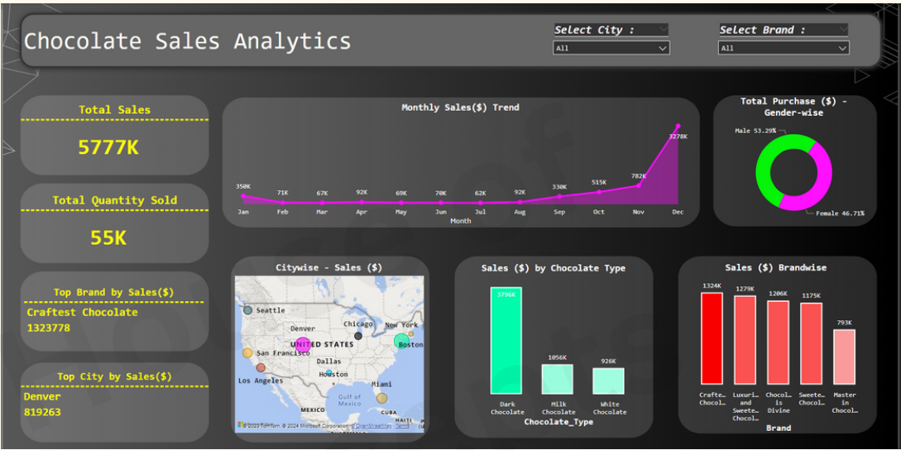
360 Degree Overview
The dashboard offers a comprehensive 360-degree view of total sales, including insights into how sales are occurring across different dimensions such as city, gender, brand, and month. In addition, it presented the overall sales value, the total quantity of chocolate sold, and identified the leading brand and city in terms of sales.

Slide 7
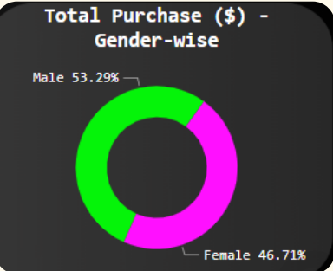
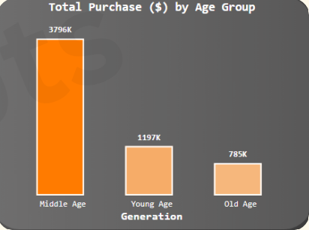
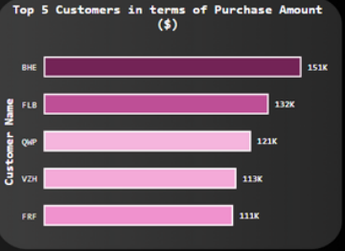
Customer Demographics
Chocolate Purchasing Trends in Relation to Gender for 2021 According to recent statistics, males accounted for 53.29% of chocolate purchases in 2021, while females accounted for 46.71%.
The Middle Age Group exhibited a higher purchase rate than both the Younger and Older Age Groups
BHE, FLB, QWP, VZH, and FRF are our top five customers regarding purchases. As a result, we need to conduct a more in-depth analysis of their purchasing patterns.

Slide 8
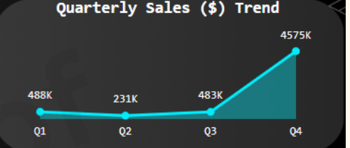
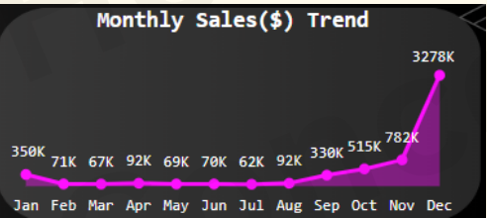
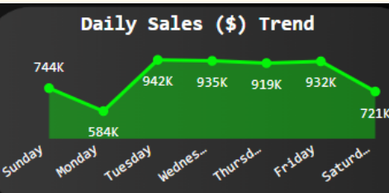
Sales Trend
The Quarterly Chocolate Sales Trend experienced an abrupt spike in Quarter 4, which is unsurprising as this period comprises several festivals.
The Monthly Sales Trend indicates positive growth overall. However, starting from August, there was a steady increase, which spiked up significantly in November and December due to the festive season
Sales for Tuesday, Wednesday, Thursday, and Friday seem to show minimal variance. However, it's noteworthy that sales experienced a significant decline on Monday, warranting further evaluation.

Slide 9
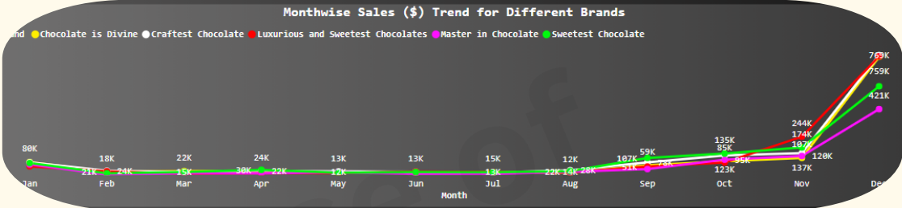
Sales Trend (contd)
Based on the overall sales trend, it can be inferred that sales increased during the Oct-Dec quarter. Additionally, there was a significant spike in sales during the month of December, attributable to the festive season. With respect to brand-wise sales, Craftest Chocolate reported the highest sales, while Master in Chocholate saw the lowest sales during December

Slide 10
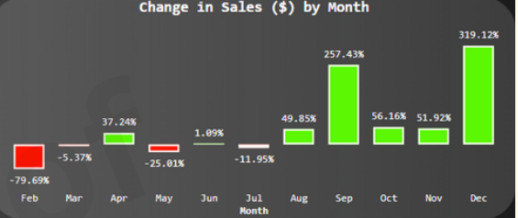
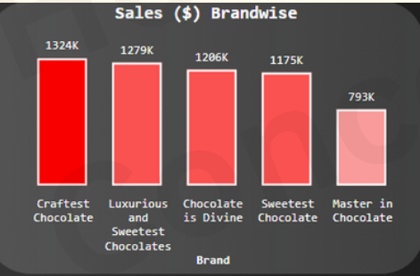
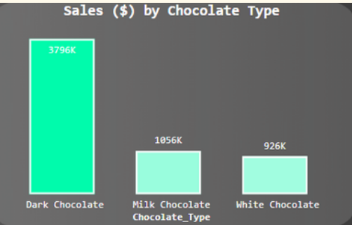
Brand & Product Statistics
There has been a notable shift in sales during the months of September and December. In February, we observed a sudden decline in sales, which can be attributed to the conclusion of the festival season. However, sales remained relatively steady during March, April, May, and June
Craftest Chocolate Brand has emerged as the highest-selling brand, while Master in Chocolate has performed poorly and finished at the bottom among the five brands.
Dark chocolate is the most popular type of chocolate, while white chocolate is not as favored.

Slide 11
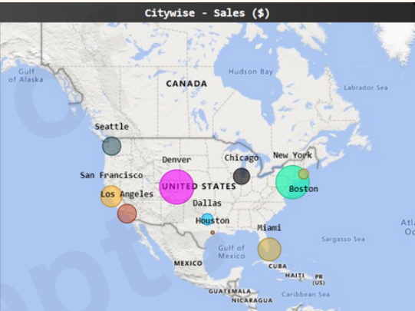
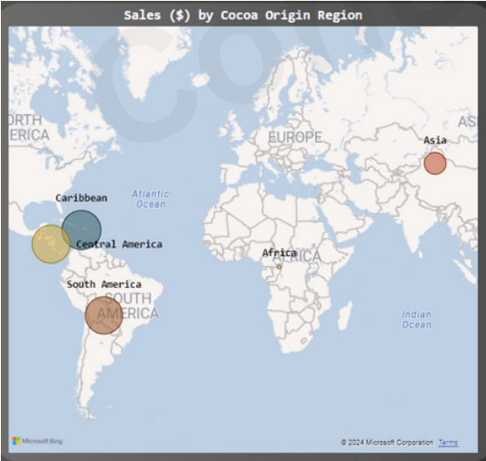
Geographical Sales
The city of Denver has recorded the highest sales in terms of revenue ($). This is evident from the size of the bubble, which indicates the same
The sales of chocolate made from the Caribbean region are the highest, while sales for chocolate made from the African region are the lowest.

Slide 12
Thank you

